Slide 1
Discrete Mathematics
South China University of Technology
1

Slide 2
Chapter 7. Relations
Representing Relations
Section 7.3
2

Slide 3
Contents
1
Representing Relations Using Matrices
2
Representing Relations Using Digraphs
3

Slide 4
Representing Relations Using Matrices
4

Slide 5
§7.3: Representing Relations
Some ways to represent n-ary relations:
With a list of n-tuples.
With a function from the (n-ary) domain to {T,F}.
Special ways to represent binary relations:
With a zero-one matrix.
With a directed graph.

Slide 6
Why bother with alternative representations? Is one not enough?
One reason: some calculations are easier using one representation, some things are easier using another
There are even some basic ideas that are suggested by a particular representation
It’s often worth playing around with different representations!

Slide 7

Using Zero-One Matrices
Any binary relation R:A×B can equally represented by an |A|×|B| 0-1 matrix
M_{R} = [m_{ij}]: m_{ij} = 1 ⇔ (a_{i},b_{j})∈R.
Example[relation ⇒ matrix].
Suppose that A = {1, 2, 3} and B = {1, 2}. R = {(2, 1), (3, 1), (3, 2)}
The 0-1 matrix:

Slide 8
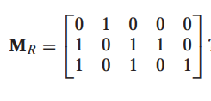
Zero-One Matrices
Example[matrix ⇒ relation].
Let A = {a1, a2, a3} and B = {b1, b2, b3, b4, b5}. What is the relation R?
R = {(a1, b2), (a2, b1), (a2, b3), (a2, b4), (a3, b1), (a3, b3), (a3, b5)}

Slide 9
Special case 1-0 matrices for a relation on A (that is, R:A×A)
Convention: rows and columns list elements in the same order

Slide 10
Zero-One Reflexive, Symmetric
Recall: Reflexive, symmetric, and antisymmetric relations.
These relation characteristics are very easy to recognize by inspection of the zero-one matrix.
any- thing
anything
anything
any- thing
Symmetric: all identical across diagonal
antisymmetric: all 1’s are across from 0’s
Reflexive: only 1’s on diagonal

Slide 11
Representing Relations Using Digraphs
11

Slide 12
Definition
A directed graph, or digraph is
G=(V, E).
V: a set of vertices ( or nodes )
E⊆V×V : a set of edges ( or arcs ), ordered pairs of V’s elements.
for edge (a,b), a is called the initial vertex, and b is called the terminal vertex.

Slide 13
Example: Digraphs ⇒ relations
Digraph G=(V, E) and relation R:
E = R
Example[Digraph ⇒ relation].
R = { (1,1),(1,3),(2,1),(2,3),(2,4),(3,1),(3,2),(4,1) }
1
2
4
3

Slide 14
Example: relations⇒ Digraphs
R2 = {(1,3),(1,4),(2,1),(2,2),(2,3),(3,1),(3,3),(4,1),(4,3) }
1
2
4
3

Slide 15
Digraph Reflexive, Symmetric
Many properties of a relation can be determined
by inspection of its graph.











Reflexive: Every node has a self-loop
Symmetric: Every link is bidirectional
Antisymmetric: No link is bidirectional

Slide 16
Particularly easy with a graph
Properties that are somehow ‘local’ to a given element, e.g.,
“does the relation contain any elements that are unconnected to any others?”
Properties that involve combinations of pairs, e.g.,
“does the relation contain any cycles?”
things to do with the composition of relations (e.g. the n-th power of R)

Slide 17
Boolean Operation
17

Slide 18
boolean algebra

Slide 19
Example 4

Slide 21
Example 5

Slide 22
Example 6

Slide 23
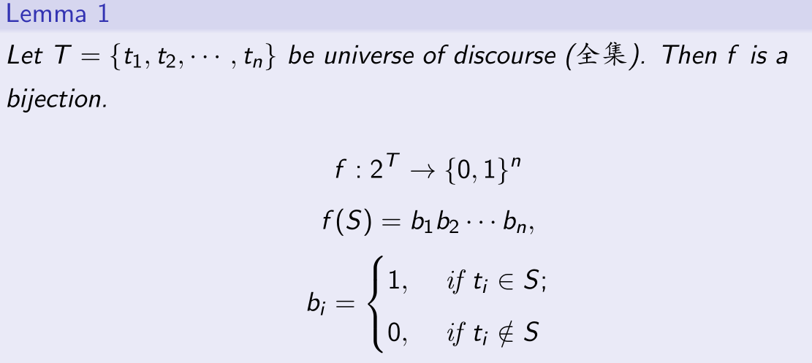
Review

Slide 24
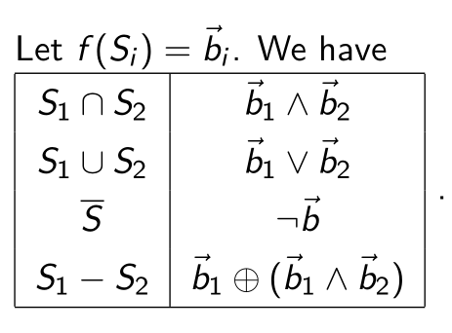
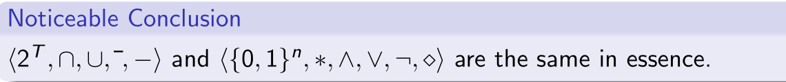
Review

Slide 25
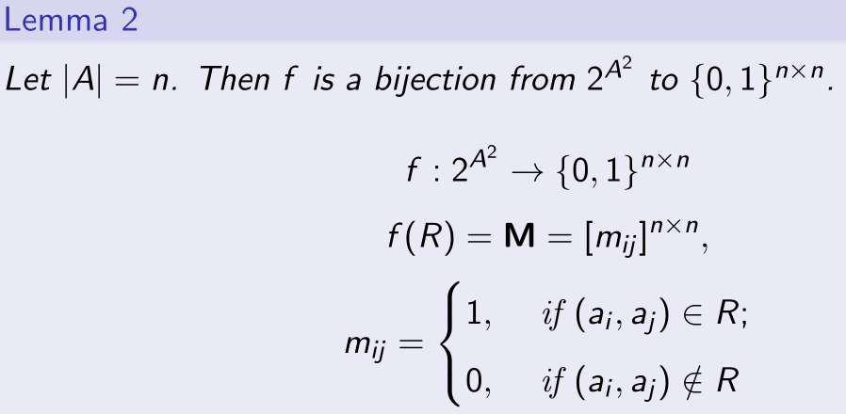
Useful fact

Slide 26
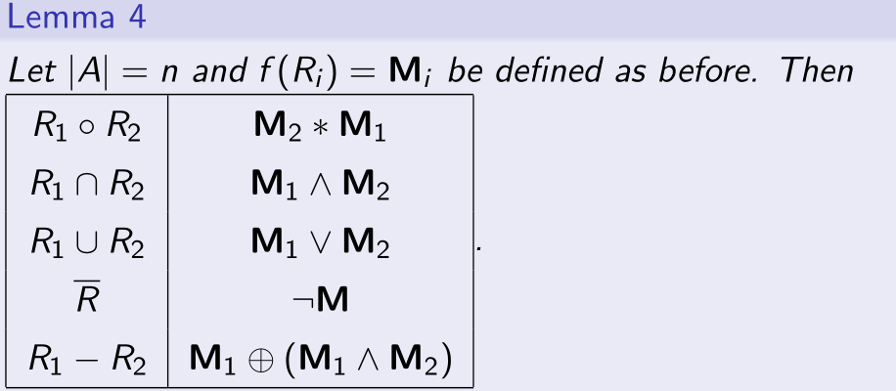
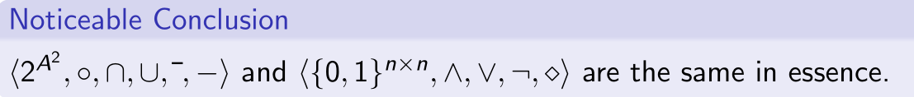
Useful fact

Slide 27
Homework
5.3: 1 c), 10-14

Slide 28
End of Section 7.3
Click to edit company slogan .
28

